Slide 1
5
Listening Skills
Hearing v/s Listening;
Barriers in Listening
1

Slide 2
Chapter Outline
What is Listening?
Process of Listening.
Importance of Listening
Types of Listening
Barriers to effective listening
How to Listen Effectively?
Benefits of Effective Listening
2

Slide 3
1.What Is Listening?
Listening is the ability to accurately receive and interpret messages in the communication process.
Listening is key to all effective communication, without the ability to listen effectively messages are easily misunderstood.
Listening is one of the most important skills you can
have.
An active process of getting information, ideas.
“Listening is the process of receiving, constructing meaning from, and responding to spoken.
3

Slide 4
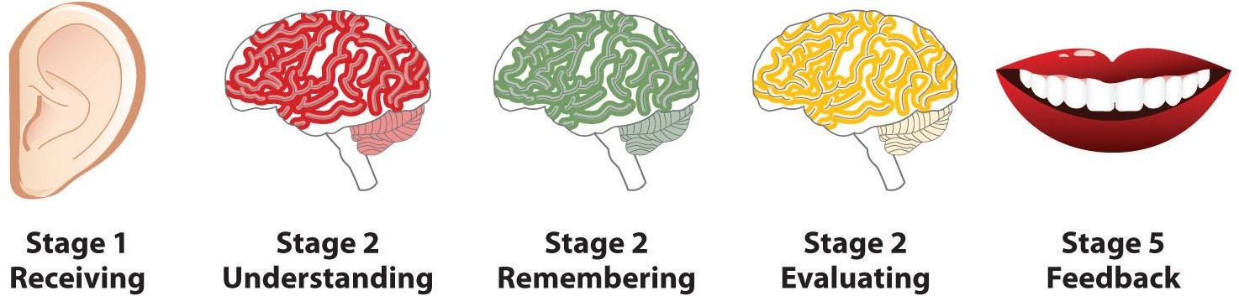
2.Process of Listening
4

Slide 5
Receiving
Receiving is the intentional focus on hearing a speaker’s message, which happens when we filter out other sources so that we can isolate the message and avoid the confusing mixture of incoming stimuli. At this stage, we are still only hearing the message. Notice in Figure 4.3, this stage is represented by the ear because it is the primary tool involved with this stage of the listening process.

Slide 6
Understanding
The understanding stage is the stage during which the listener determines the context and meanings of the words that are heard through a process called decoding. Understanding or comprehension occurs when the listener’s determination of the context and meanings of the words matches the speaker’s message. One tactic for better understanding a speaker’s meaning is to ask questions to fill in any holes you may have in the mental reconstruction of the speaker’s message.

Slide 7
Remembering
In the listening process, the remembering stage occurs as the listener categorizes and retains the information he or she has gathered from the speaker for future access. If the listener has been attending, understanding, and evaluating, chances are the result will be stored memory— allowing the listener to record information about people, objects, and events for later recall. This happens both during and after the speaker’s delivery.

Slide 8
Evaluating
This stage of the listening process is the one during which the listener assesses the information they received, both qualitatively and quantitatively. Evaluating allows the listener to form an opinion of what they heard and, if necessary, to begin developing a response. The evaluating stage occurs most effectively once the listener fully understands what the speaker is trying to say. Having a clear understanding of a speaker’s message allows a listener to evaluate that message without getting bogged down in ambiguities or spending unnecessary time and energy addressing points that may be tangential or otherwise nonessential.

Slide 9
Feedback/Response
The responding stage is the stage of the listening process in which the listener provides verbal and/or nonverbal reactions based on short- or long-term memory. Nonverbal responses such as nodding or eye contact allow the listener to communicate his or her level of interest without interrupting the speaker, thereby preserving the speaker/listener roles. When a listener responds verbally to what they hear and remember—for example, with a question or a comment—the speaker/listener roles are reversed, at least momentarily.

Slide 10
3. Importance of Listening
We show that we are serious
We display respect to other’s view point
Helps us to learn
Helps us to adapt and understand
Empathize
11

Slide 11
Listening builds trust
Listening reduces misunderstandings
Listening helps eliminate conflict
Listening improves business relationships
Listening increases your productivity
Listening improves your leadership skills

Slide 12
Why Listening is Important?
To avoid communication errors.
Helps to learn something new.
It is the key to success.

Slide 13
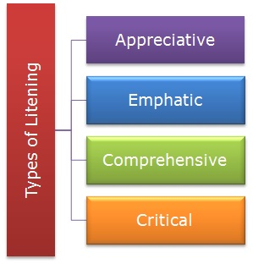
4. Types of Listening
Appreciative Listening
Emphatic listening
Comprehensive Listening
Critical Listening

Slide 14
Appreciative Listening
Appreciative listening refers to the listening behavior where the listener seeks certain information to appreciate and meet their needs and goals. It is one kind of selective listening. Appreciative listeners are intended to listen to particular information that is important for them.
For example, I listen to a favorite song and poetry to seek the exciting words of the speech. Additionally, I am listening to a political speech to find out motivational words.

Slide 15
Empathetic listening
Empathic listening is understood as the feeling and emotions of the speaker; sometimes, the listener can feel what the speaker is feeling. Therefore, this listening needs good close attention, discriminative listening, comprehensive listening, and deep connection with the emotion of the speakers.
For example, the Audience is thinking about the same things that the speaker is thinking.

Slide 16
Comprehensive Listening
Comprehensive Listening means understanding the meaning of the message rather than interpreting only the sound of the message. It is an active process of seeking the meaning of the message. Actually, It is the initial process of meaning the verbal and nonverbal communication messages, thoughts, ideas, and opinions. Listeners use knowledge and vocabulary to understand the meaning of the speaker’s message. It is not only the meaning of the words but also something more than that.

Slide 17
Critical listening
Critical listening is the fourth kind of listening where listeners have to evaluate the message. Listeners have to critically respond to the message and give their opinion. Critical listening is listening in order to evaluate and judge, forming opinion about what is being said. Judgment includes assessing strengths and weaknesses, agreement and approval.
This form of listening requires significant real-time cognitive effort as the listener analyses what is being said, relating it to existing knowledge and rules, whilst simultaneously listening to the on-going words from the speaker.

Slide 18
5. Barriers to Effective Listening
1. External Listening Barriers
External listening barriers are easier to manage than internal barriers. They include a variety of environmental distractions that can usually be avoided or minimized with simple corrections, like removing yourself from the interfering barrier or removing the issue from the area that you are in. External barriers include:
Noise. Any external noise can be a barrier, like the sound of equipment running, phones ringing, or other people having conversations.

Slide 19
Visual distractions.
Visual distractions can be as simple as the scene outside a window or the goings-on just beyond the glass walls of a nearby office.
Physical setting.
An uncomfortable temperature, poor or nonexistent seating, bad odors, or distance between the listener and speaker can be an issue.
Objects.
Items like pocket change, pens, and jewelry are often fidgeted with while listening.
The person speaking.
The person listening may become distracted by the other person’s personal appearance, mannerisms, voice, or gestures.

Slide 20
2. Internal Listening Barriers
Internal listening barriers are more difficult to manage, as they reside inside the mind of the listener. Internal barriers’ elimination relies on a high level of self-awareness and discipline on the part of the listener, like catching oneself before the mind starts to wander and bringing full attention back to the speaker. Internal barriers include:
Anxiety. Anxiety can take place from competing personal worries and concerns.

Slide 21
Self-centeredness.
This causes the listener to focus on his or her own thoughts rather than the speaker’s words.
Mental laziness.
Laziness creates an unwillingness to listen to complex or detailed information.
Boredom.
Boredom stems from a lack of interest in the speaker’s subject matter.
Sense of superiority.
This leads the listener to believe they have nothing to learn from the speaker.
Cognitive dissonance.
The listener hears only what he or she expects or molds the speaker’s message to conform with their own beliefs.
Impatience.
A listener can become impatient with a speaker who talks slowly or draws out the message.

Slide 22
Some Common Barriers to Effective Listening
Some common barriers in the process of listening are listed below.
Pre-judgments about the speaker .
Assuming that the speaker is going to give some unimportant information .
Arriving late for a speech, presentation or lecture .
Judging the speaker by his/her mannerisms, voice, appearance, accent, etc.
Lack of concentration/interest .
Avoiding listening to difficult, boring or complex information and selectively listening only to what is considered interesting.
Speaker or listener being distracted by disturbances .

Slide 23
6. How To Listen Effectively?
Take notes
Stop Talking – Be Silent
Show Interest
Empathize
Ask Questions
Maintain Eye Contact
6. Listen Creatively
7. Put Your Entirety
8. Send feedback
9. Avoid or eliminate distraction
10. Try to gather information about the topic to develop interest and familiarity.
20

Slide 24
7. Benefits of Effective Listening
Enhances productivity
Improves relations
Avoids conflicts
Improves understanding
Improves negotiation skills
Adds to your Image & Personality
21

Slide 25
Exercise
..\..\..\..\videoplayback.mp4
https://www.esolcourses.com/content/topics/animals/stories/hippo-that-lives-in-a-house.html

Slide 26

Any Question

Slide 27
Thank You For Listening

